Slide 1
REPUBLIC OF CROATIA
Ministry of Justice and Public Administration
Zagreb, September 2021
Zagreb, 2021

Slide 2
National Recovery and Resilience Plan
Comprises reforms and investments in six components (Economy; Public administration, justice and state assets; Education, science and research; Labour market and social protection; Healthcare, and Initiative: Renovation of buildings)
82 reforms and 241 investments
Value of approx. HRK 47.5 billion
40% for the green dimension – HRK 19 billion
20% for the digital dimension – HRK 9.5 billion
10% of resources for public administration, justice and state assets

Slide 3
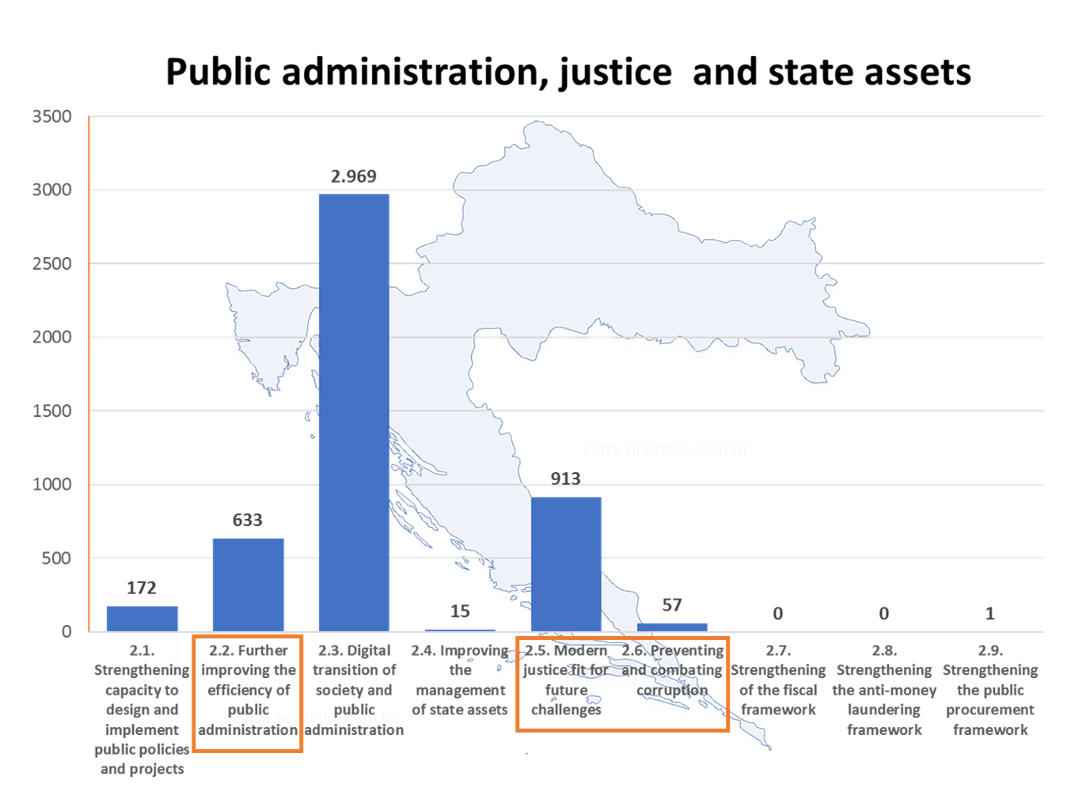
National Recovery and Resilience Plan 2021-2026
Total investments in public administration and justice HRK1.6 b

Slide 4
National Recovery and Resilience Plan

Slide 5
Further improving the efficiency of public administration
Activities under the component are aimed at improving the recruitment process, new wage and work models in the civil service, digital transformation of conservation bases and archive records, and functional and sustainable local government
Four reforms and seven investments
Total value of investments over HRK 633 million

Slide 6
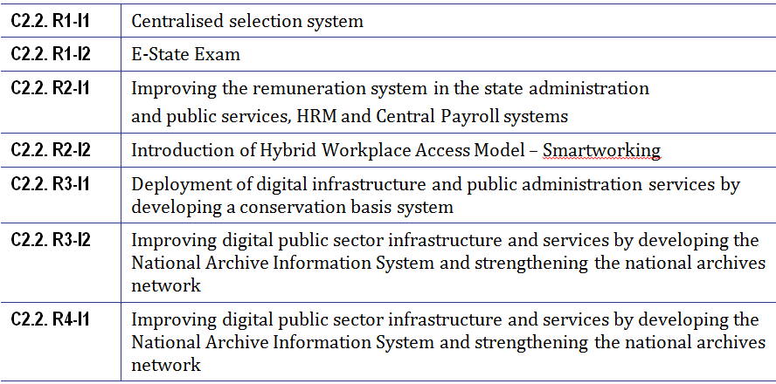
INVESTMENTS

Slide 7
Modern JUSTICE FIT FOR FUTURE CHALLENGES
The aim of the reform measures under this subcomponent is to increase the efficiency of the justice system, speed up proceedings, reduce backlogs and continue with investments in infrastructure and digitalisation of the justice system.
One reform measure and six investments
Value of investments over HRK 913 million

Slide 8
Regulatory activities aimed at increasing the efficiency of the justice system
Improving the efficiency of courts by implementing Action Plans
Optimising business processes in courts, more efficient court case management and support for transparency in court proceedings
Strengthening the lifelong learning system for judicial officials and other participants in court proceedings
Reform of civil litigation procedure
Reform of criminal procedure
Reform of conciliation institute
Introducing the institute of voluntary conciliation and e-communication in administrative disputes
Reform of insolvency and consumer insolvency procedures
Improvement of the valid Land Registry Act
Amendments to the valid legislative framework for public notaries related to the use of modern technologies
Reform of non-contentious procedure
Establishment of specialised family units at municipal courts
Amendments to the regulatory framework for court-appointed experts and interpreters

Slide 9
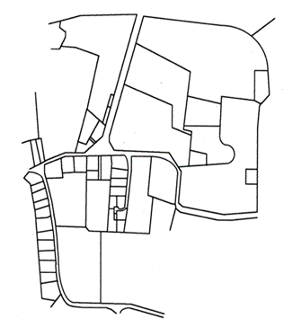
INVESTMENTS
Enhancing the Court Case Management System (eSpis)
Improvement of land register information system and cadastre
Developing a toolkit for the publication and search of court decisions
Design and implementation of the Zagreb Justice Square to improve access to justice and efficiency of commercial proceedings and administrative disputes
Implementation of energy efficiency measures to renovate obsolete facilities of judicial authorities
Stable and resilient IT infrastructure for the Justice Information System

Slide 10
Preventing and combating corruption
Reforms under this subcomponent are aimed at preventing corruption, raising public awareness of the damaging effects of corruption and strengthening independent authorities in their implementation of the anti-corruption policy.
Four reforms and four investments
The activities will be contained in the new Anti-Corruption Strategy 2021-2030 (drafting underway)
Value of investments over HRK 57 million

Slide 11
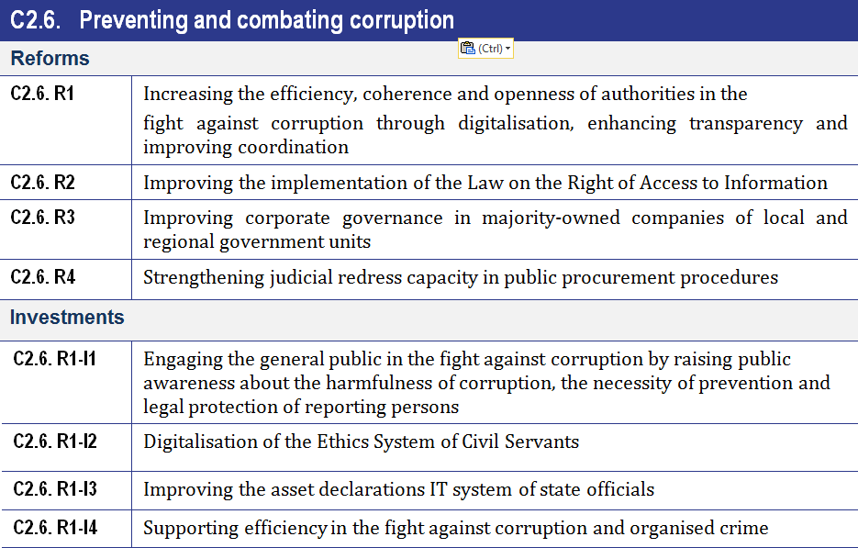

Slide 12
National Recovery and Resilience Plan 2021-2026
The objectives of envisaged reforms and investments are:
improvement of public administration and the justice system
speeding up proceedings and increasing their efficiency through legislative activities
quality human resource management – more transparent recruitment and continuous education
introduction of new digital tools to facilitate and speed up citizens’ access to justice and public administration
better quality work conditions through infrastructure projects
strengthening government and judicial authorities, making them more modern and efficient.

Slide 13
Thank you for your attention!

